Slide 1
Speaker Identification
Attendance
Marking
System

Slide 2
Contents
Gaussian Mixture Model(GMM)
01
04
Objective
02
System Architecture
05
Demonstration and Implementation
03
History
06
Future Works and Conclusion

Slide 3
Objective
The primary aim of our project is to develop a Speaker Identification-based Attendance Marking System with a focus on accurately identifying speakers, detecting their presence, and automating the attendance marking process. The key objectives that contribute to achieving this aim are
Speaker Identification Accuracy
Real-time Presence Detection
Contactless Attendance
User-Friendly Interface

Slide 4
Concept Behind Audio Analysis
Speaker recognition (SR) is a process of identifying a person from his or her characteristic voice
No two individuals sound identical because of their vocal tract shapes, larynx sizes, and other different voice production organs
In addition to these physical differences, each individual has his or her own speaking style, pronunciation pattern, choice of vocabulary, and so on
Each voice has a certain range of frequencies. It is this range that determines the kind of voice a person has.
The pitch of voice depends upon the length of the vocal cords

Slide 5
Technology
Language: python 3.11
Library: python_speech_features
Features: MFCC + Delta-MFCC
Model training: GMM

Slide 6
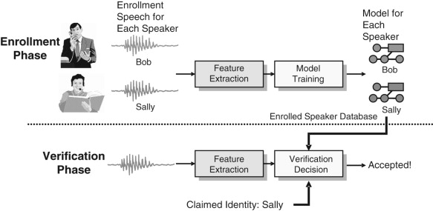
System Working

Slide 7
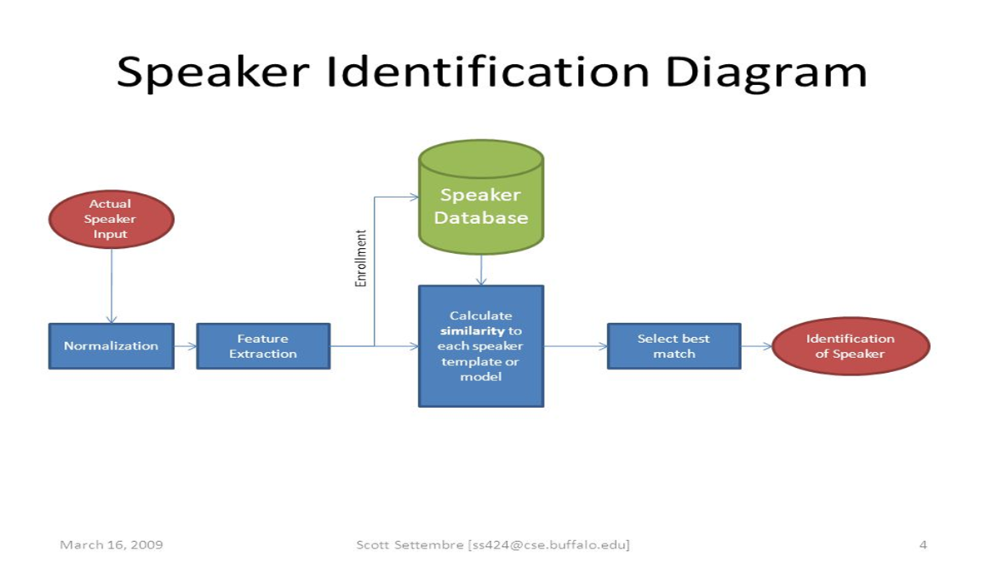

Slide 8
Process
This can be summarized in 4 basic Phases:
Data Acquisition
Feature Extraction
Model Training
Perform Testing (Identification)

Slide 9
Data Acquisition
We tested our model’s working and accuracy on a downloaded dataset; viz. VoxForge DATASET.

Slide 10
Mel Frequency Cepstral Coefficient(MFCC)
MFCC is a feature extraction technique widely used in speech and audio processing. MFCCs are used to represent the spectral characteristics of sound in a way that is well-suited for various machine learning tasks, such as speech recognition and music analysis.
MFCCs are a set of coefficients that capture the shape of the power spectrum of a sound signal.
They are derived by first transforming the raw audio signal into a frequency domain using a technique like the Discrete Fourier Transform (DFT), and then applying the mel-scale to approximate the human auditory perception of sound frequency. Finally, cepstral coefficients are computed from the mel-scaled spectrum.

Slide 11
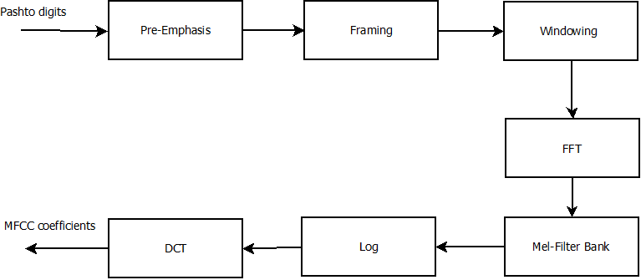
Mel Frequency Cepstral Coefficient(MFCC)
Finally, cepstral coefficients are computed from the mel-scaled spectrum.
MFCCs are particularly useful because they emphasize features of the audio signal that are important for human speech perception while discarding less relevant information. This makes them effective for tasks like speaker recognition, emotion detection, and speech-to-text conversion.

Slide 12
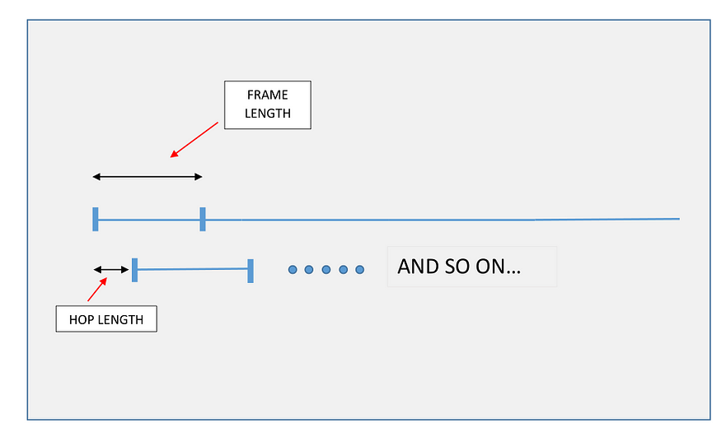
Preemphasis:
Preemphasis increases the magnitude of energy in the higher frequency. When we look at the frequency domain of the audio signal for the voiced segments like vowels, it is observed that the energy at a higher frequency is much lesser than the energy in lower frequencies. Boosting the energy in higher frequencies will improve the phone detection accuracy thereby improving the performance of the model.
Framing:
We need to split the signal into short-time frames. The rationale behind this step is that frequencies in a signal change over time, so in most cases it doesn’t make sense to do the Fourier transform across the entire signal in that we would lose the frequency contours of the signal over time. Frame the signal into 20–40 ms frames. 25ms is standard.

Slide 13
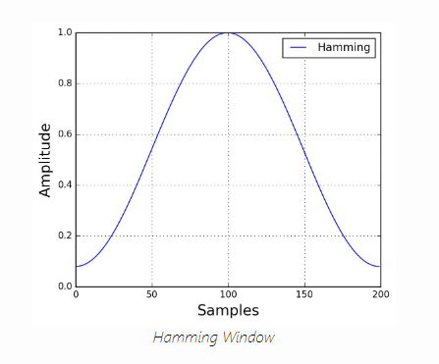
Windowing :
Windowing is essentially applied to notably counteract the assumption made by the Fast Fourier Transform that the data is infinite and to reduce spectral leakage.

Slide 14
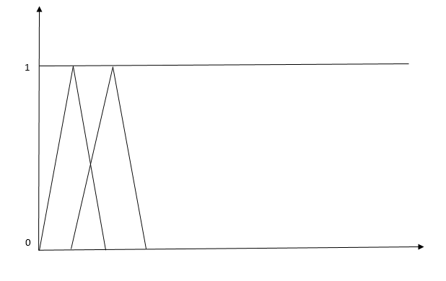
Calculation of the Discrete Fourier Transform:
We can now do an NN-point FFT on each frame to calculate the frequency spectrum, which is also called Short-Time Fourier-Transform (STFT).
Applying Filter Banks :
The Mel spaced Filter Bank as stated formally is a set of 20–40 triangular filters. Two adjacent filters are described below:

Slide 15
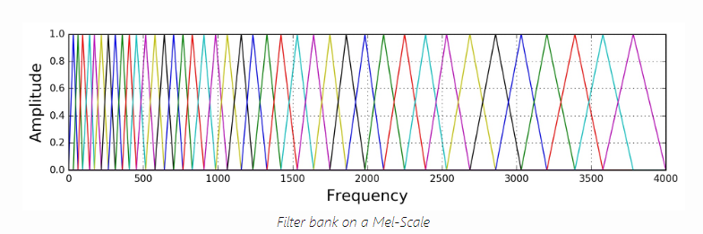
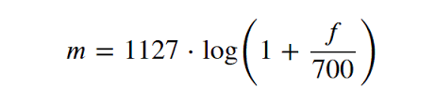
Mel-Filter Bank:
Our filterbank comes in the form of 40 vectors .Each vector is mostly zeros, but is non-zero for a certain section of the spectrum. To calculate filterbank energies we multiply each filterbank with the power spectrum, then add up the coefficents. Once this is performed we are left with 40 numbers that give us an indication of how much energy was in each filterbank.
In above graph frequency is plotted in mel scale. The Frequency to MEL conversion formula is given as:

Slide 16
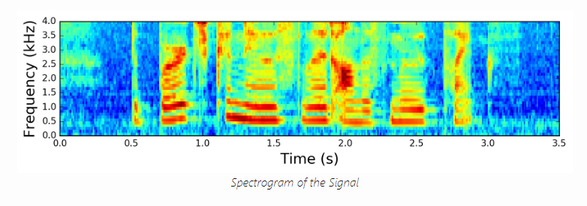
These coefficients are then converted back to hertz
Log
We now apply the log of these spectrogram values to get the log filterbank energies.
DCT
The issues with this spectrogram is that these Filter bank coefficients are highly correlated So, we need to decorrelate these coefficients.So for this DCT (Discrete cosine transform) is applied

Slide 17
Model Training using GMM
GMM approach
Decision Logic
04
The speaker identification system module can be separated into 4 modules :
Speaker Database
03
Speaker Modelling
02
Front End Processing
01

Slide 18
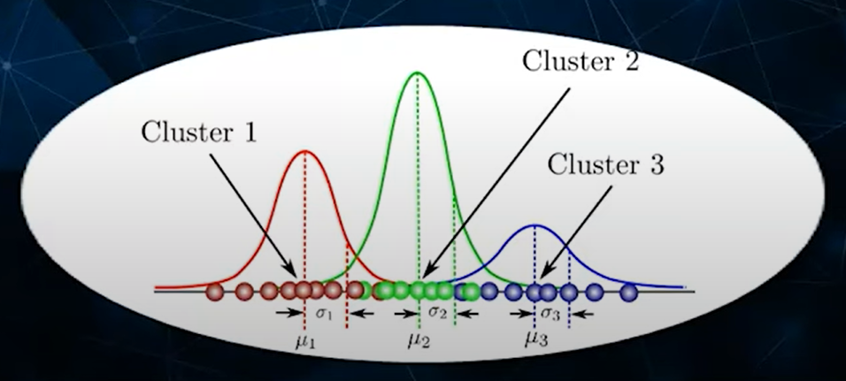
What is Gaussian Mixture Model ?
A Gaussian Mixture Model is a probabilistic model Representing data as a mixture of multiple Gaussian distributions.
It is mixture model because it assumes that data points are generated from a mix of gaussian distribution each associated with a certain probability.
Each Gaussian distribution represents a component or cluster within the data.
The model assumes that the data points within each cluster are generated from a gaussian distribution with its mean and covariance
The GMM combine these component distribution with mixture weight to form the overall probability distribution of the data

Slide 19
Key Components of Gaussian Model are :
Number of components: The GMM assumes that the data is a mixture of specific number of gaussian distributions also known as components or cluster.
The number of components is typically determined in advanced or estimated by using techniques such as model selection.
Gaussian distribution: Each component in the GMM is represented by a Gaussian Distribution also known as Normal distribution.
It is bell shaped curve fully described by its mean and covariance
Mean- Centre of the distribution ; Covariance- Spread or shape
Mixture Weights: The GMM assigns mixture weights to each component, representing the probability of selecting that component when generating a data.

Slide 20
Why GMM is preferred ?
Real World examples where GMM can be used
GMM is more reliable than others.
GMM yields output more faster than others.
It consumes optimal resources than compared to other models.
Medical Dataset Analysis
Modelling Natural Phenomena
Customer Behaviour Analysis
Stock Price Prediction
Gene Expression Data Analysis

Slide 21
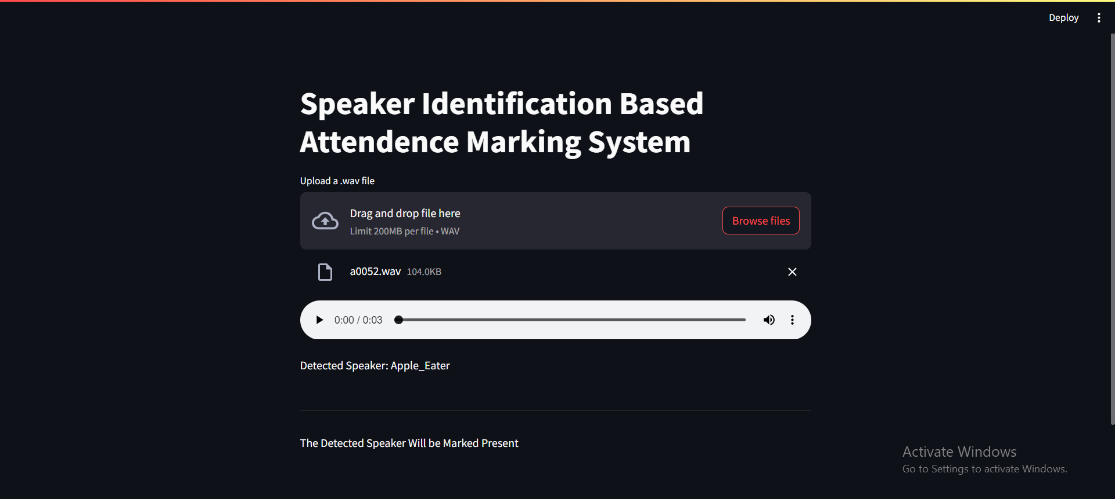
Result

Slide 22
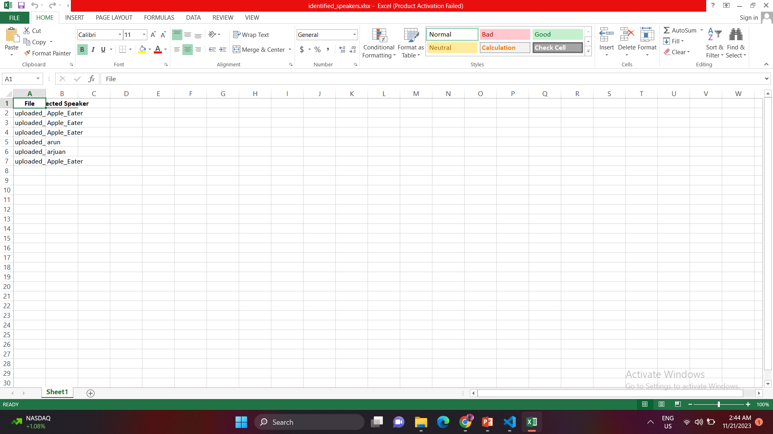
Result
The Detected Speaker is marked present in the excel attendance sheet

Slide 23
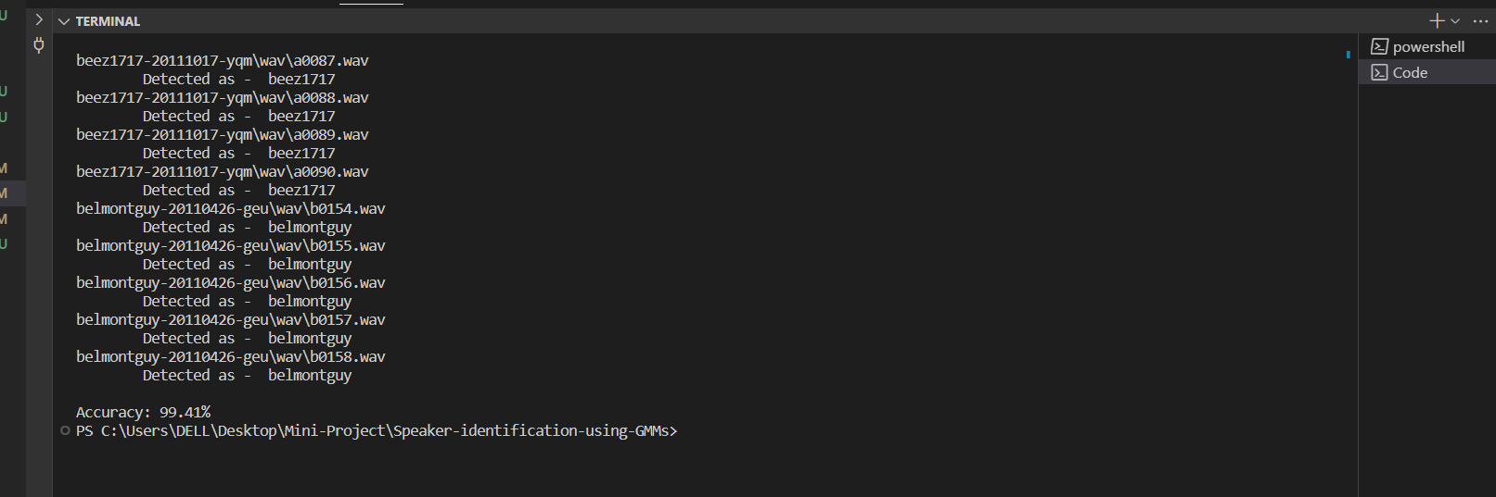
Result
Accuracy-99.41% when we train 5 Audio files from each speaker

Slide 24
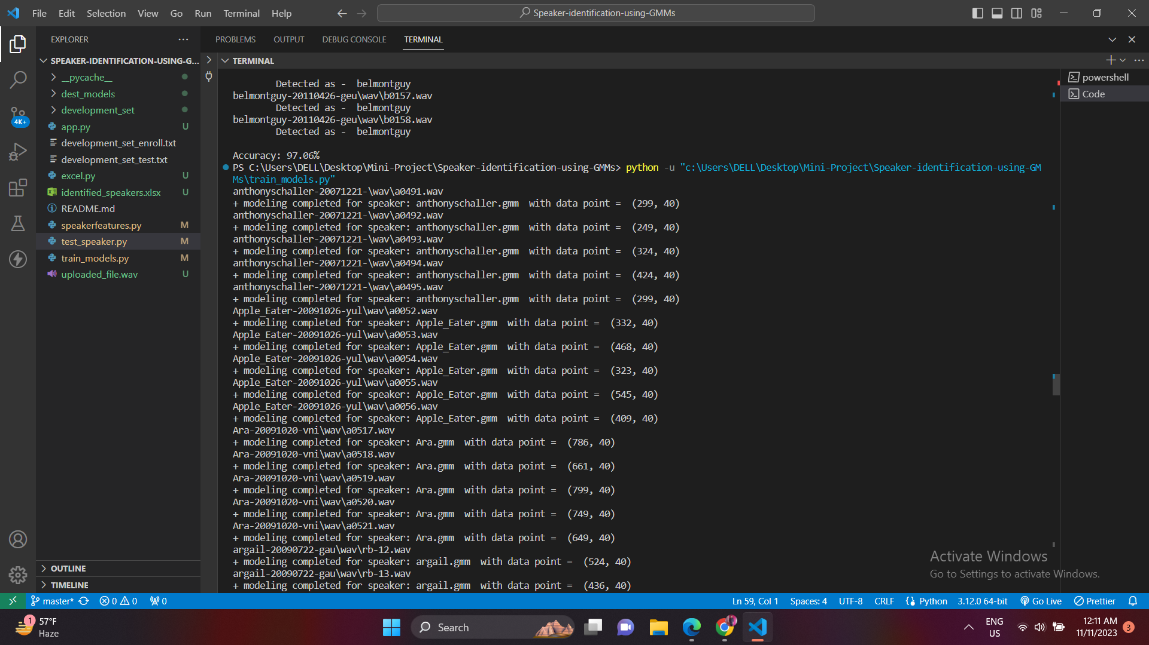
Result
Accuracy-97.06% when we train 3 Audio files from each speaker

Slide 25
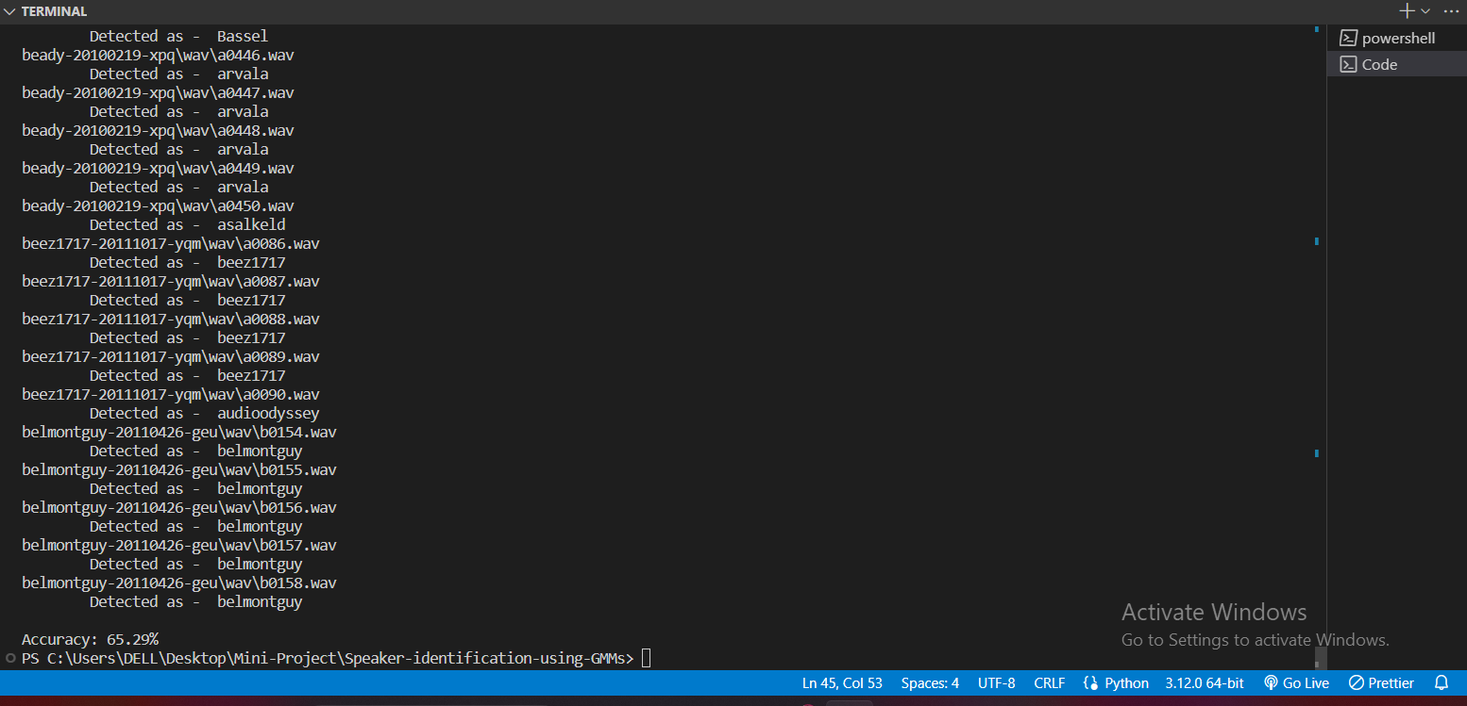
Result
Accuracy-65.23% when we train 1 Audio file from each speaker

Slide 26
Future Works
Train with Student Audio Dataset
01
02
Deep Learning Integration
Mobile Application Integration
03
Real-time Feedback and Alerts
04
Cloud Integration:
05
06
Subject-wise Attendance
Further Works

Slide 27
Conclusion
Throughout this project, we've achieved our objectives of creating an innovative system that streamlines attendance processes.
Our Speaker Identification-based Attendance Marking System not only addresses the challenges of traditional attendance methods but also sets a standard for intelligent, efficient, and contactless attendance management

